Slide 1
Computer Architecture
Vivek Shrivastava
IIPS, DAVV

Slide 2
Program Concept
Hardwired systems are inflexible
General purpose hardware can do different tasks, given correct control signals
Instead of re-wiring, supply a new set of control signals

Slide 3
What is a program?
A sequence of steps
For each step, an arithmetic or logical operation is done
For each operation, a different set of control signals is needed

Slide 4
Function of Control Unit
For each operation a unique code is provided
e.g. ADD, MOVE
A hardware segment accepts the code and issues the control signals
We have a computer!

Slide 5
Components
The Control Unit and the Arithmetic and Logic Unit constitute the Central Processing Unit
Data and instructions need to get into the system and results out
Input/output
Temporary storage of code and results is needed
Main memory

Slide 6
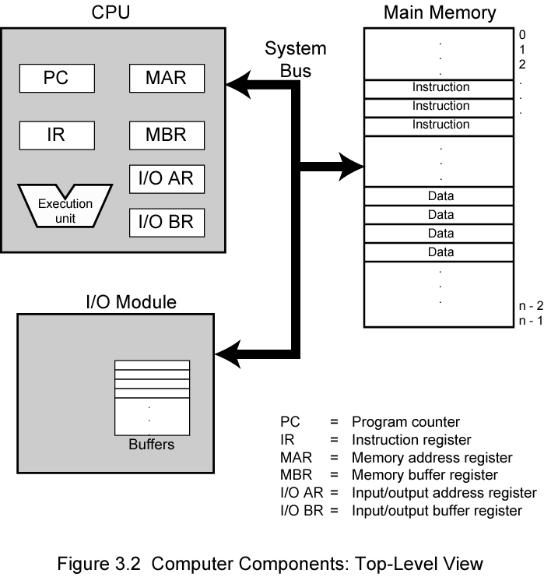
Computer Components: Top Level View

Slide 7
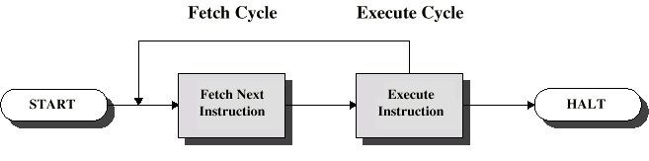
Instruction Cycle
Two steps:
Fetch
Execute

Slide 8
Fetch Cycle
Program Counter (PC) holds address of next instruction to fetch
Processor fetches instruction from memory location pointed to by PC
Increment PC
Unless told otherwise
Instruction loaded into Instruction Register (IR)
Processor interprets instruction and performs required actions

Slide 9
Execute Cycle
Processor-memory
data transfer between CPU and main memory
Processor I/O
Data transfer between CPU and I/O module
Data processing
Some arithmetic or logical operation on data
Control
Alteration of sequence of operations
e.g. jump
Combination of above

Slide 10
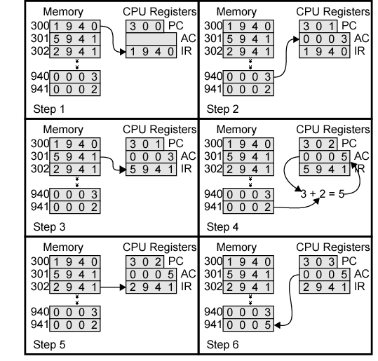
Example of Program Execution

Slide 11
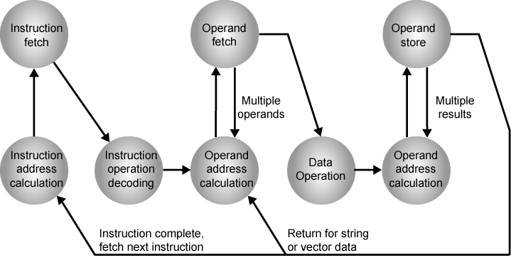
Instruction Cycle State Diagram

Slide 12
Interrupts
Mechanism by which other modules (e.g. I/O) may interrupt normal sequence of processing
Program
e.g. overflow, division by zero
Timer
Generated by internal processor timer
Used in pre-emptive multi-tasking
I/O
from I/O controller
Hardware failure
e.g. memory parity error

Slide 13
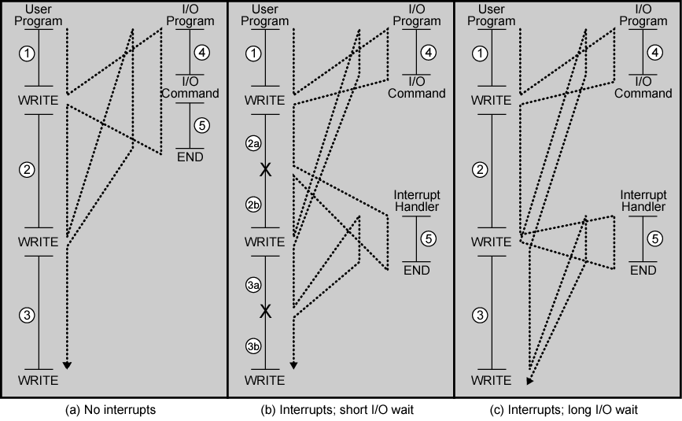
Program Flow Control

Slide 14
Interrupt Cycle
Added to instruction cycle
Processor checks for interrupt
Indicated by an interrupt signal
If no interrupt, fetch next instruction
If interrupt pending:
Suspend execution of current program
Save context
Set PC to start address of interrupt handler routine
Process interrupt
Restore context and continue interrupted program

Slide 15
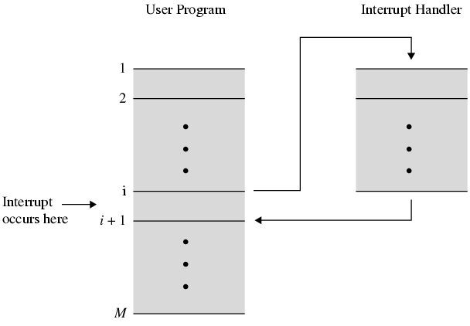
Transfer of Control via Interrupts

Slide 16
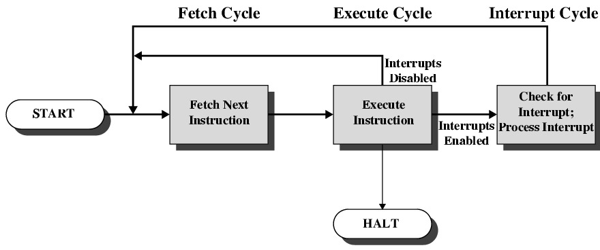
Instruction Cycle with Interrupts

Slide 17
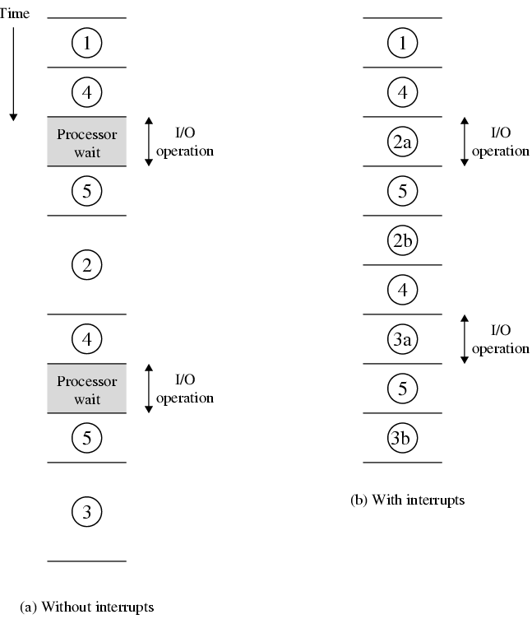
Program Timing Short I/O Wait

Slide 18
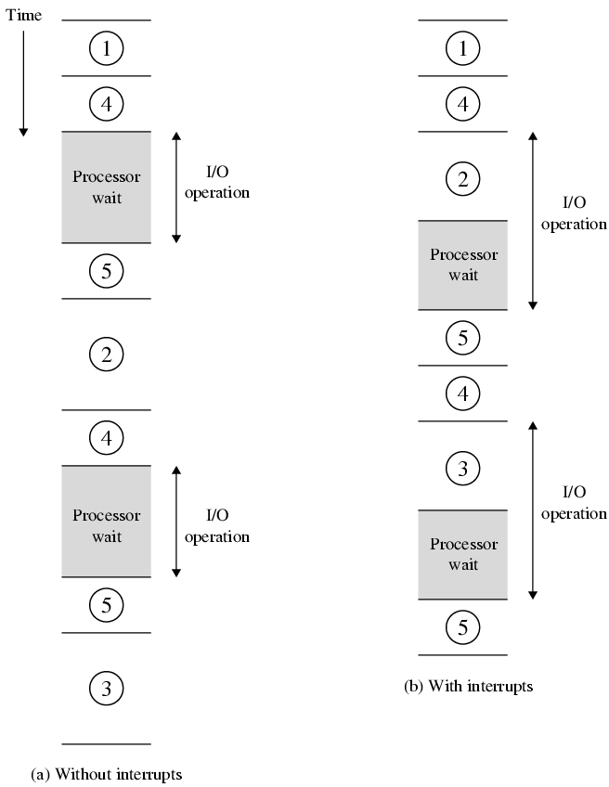
Program Timing Long I/O Wait

Slide 19
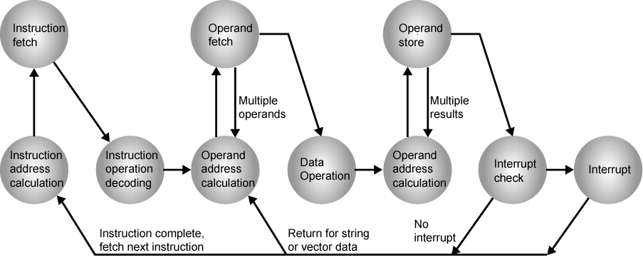
Instruction Cycle (with Interrupts) - State Diagram

Slide 20
Multiple Interrupts
Disable interrupts
Processor will ignore further interrupts whilst processing one interrupt
Interrupts remain pending and are checked after first interrupt has been processed
Interrupts handled in sequence as they occur
Define priorities
Low priority interrupts can be interrupted by higher priority interrupts
When higher priority interrupt has been processed, processor returns to previous interrupt

Slide 21
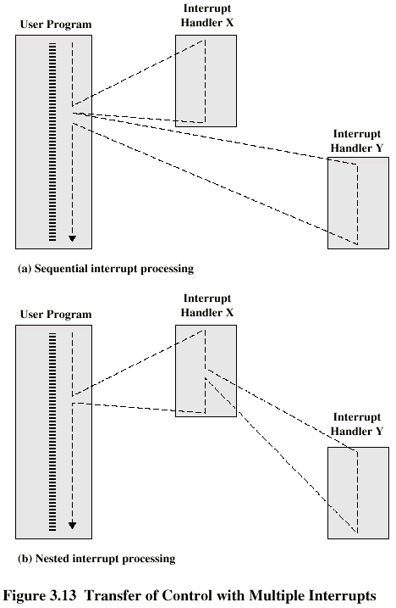
Multiple Interrupts - Sequential

Slide 22
Multiple Interrupts – Nested

Slide 23
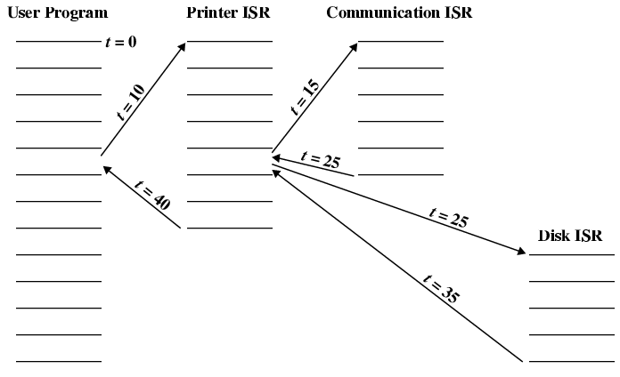
Time Sequence of Multiple Interrupts

Slide 24
Connecting
All the units must be connected
Different type of connection for different type of unit
Memory
Input/Output
CPU

Slide 25
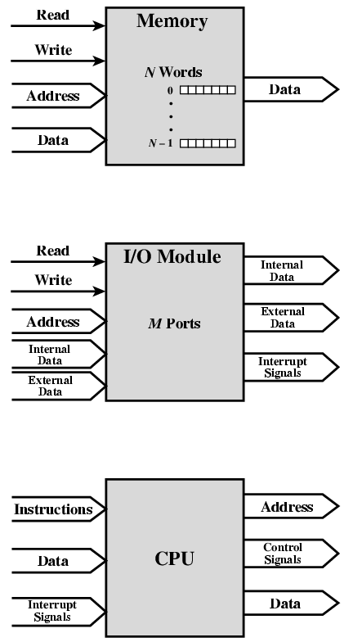
Computer Modules

Slide 26
Memory Connection
Receives and sends data
Receives addresses (of locations)
Receives control signals
Read
Write
Timing

Slide 27
Input/Output Connection(1)
Similar to memory from computer’s viewpoint
Output
Receive data from computer
Send data to peripheral
Input
Receive data from peripheral
Send data to computer

Slide 28
Input/Output Connection(2)
Receive control signals from computer
Send control signals to peripherals
e.g. spin disk
Receive addresses from computer
e.g. port number to identify peripheral
Send interrupt signals (control)

Slide 29
CPU Connection
Reads instruction and data
Writes out data (after processing)
Sends control signals to other units
Receives (& acts on) interrupts

Slide 30
Buses
There are a number of possible interconnection systems
Single and multiple BUS structures are most common
e.g. Control/Address/Data bus (PC)
e.g. Unibus (DEC-PDP)

Slide 31
What is a Bus?
A communication pathway connecting two or more devices
Usually broadcast
Often grouped
A number of channels in one bus
e.g. 32 bit data bus is 32 separate single bit channels
Power lines may not be shown

Slide 32
Data Bus
Carries data
Remember that there is no difference between “data” and “instruction” at this level
Width is a key determinant of performance
8, 16, 32, 64 bit

Slide 33
Address bus
Identify the source or destination of data
e.g. CPU needs to read an instruction (data) from a given location in memory
Bus width determines maximum memory capacity of system
e.g. 8080 has 16 bit address bus giving 64k address space

Slide 34
Control Bus
Control and timing information
Memory read/write signal
Interrupt request
Clock signals

Slide 35
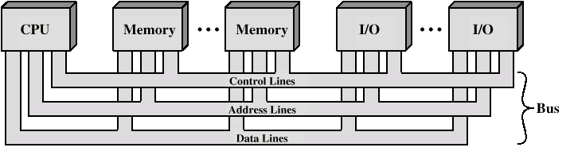
Bus Interconnection Scheme

Slide 36
Big and Yellow?
What do buses look like?
Parallel lines on circuit boards
Ribbon cables
Strip connectors on mother boards
e.g. PCI
Sets of wires

Slide 37
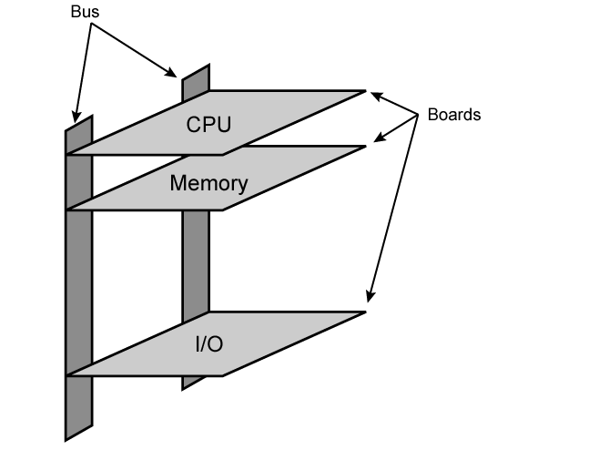
Physical Realization of Bus Architecture

Slide 38
Single Bus Problems
Lots of devices on one bus leads to:
Propagation delays
Long data paths mean that co-ordination of bus use can adversely affect performance
If aggregate data transfer approaches bus capacity
Most systems use multiple buses to overcome these problems

Slide 39
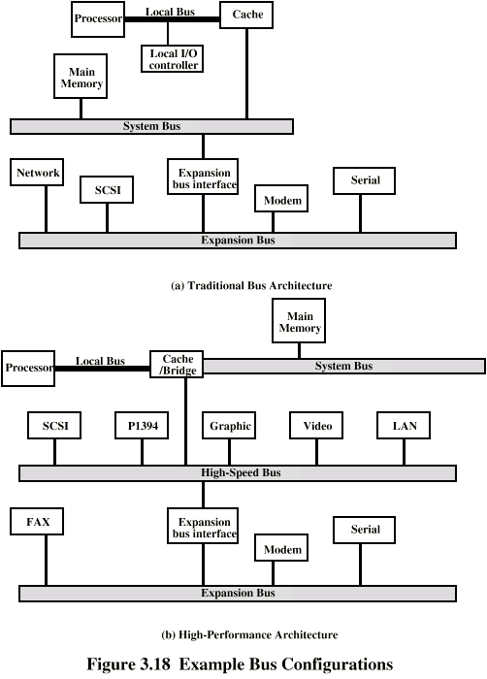
Traditional (ISA) (with cache)

Slide 40
High Performance Bus

Slide 41
Bus Types
Dedicated
Separate data & address lines
Multiplexed
Shared lines
Address valid or data valid control line
Advantage - fewer lines
Disadvantages
More complex control
Ultimate performance

Slide 42
Bus Arbitration
More than one module controlling the bus
e.g. CPU and DMA controller
Only one module may control bus at one time
Arbitration may be centralised or distributed

Slide 43
Centralised or Distributed Arbitration
Centralised
Single hardware device controlling bus access
Bus Controller
Arbiter
May be part of CPU or separate
Distributed
Each module may claim the bus
Control logic on all modules

Slide 44
Timing
Co-ordination of events on bus
Synchronous
Events determined by clock signals
Control Bus includes clock line
A single 1-0 is a bus cycle
All devices can read clock line
Usually sync on leading edge
Usually a single cycle for an event

Slide 45
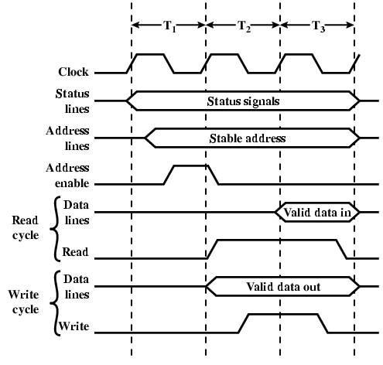
Synchronous Timing Diagram

Slide 46
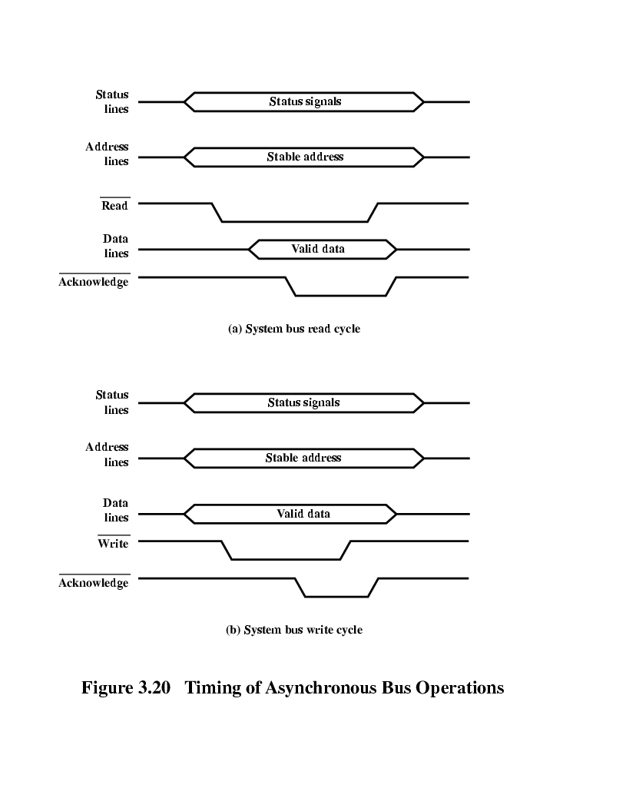
Asynchronous Timing – Read Diagram

Slide 47
Asynchronous Timing – Write Diagram

Slide 48
PCI Bus
Peripheral Component Interconnection
Intel released to public domain
32 or 64 bit
50 lines

Slide 49
PCI Bus Lines (required)
Systems lines
Including clock and reset
Address & Data
32 time mux lines for address/data
Interrupt & validate lines
Interface Control
Arbitration
Not shared
Direct connection to PCI bus arbiter
Error lines

Slide 50
PCI Bus Lines (Optional)
Interrupt lines
Not shared
Cache support
64-bit Bus Extension
Additional 32 lines
Time multiplexed
2 lines to enable devices to agree to use 64-bit transfer
JTAG/Boundary Scan
For testing procedures

Slide 51
PCI Commands
Transaction between initiator (master) and target
Master claims bus
Determine type of transaction
e.g. I/O read/write
Address phase
One or more data phases

Slide 52
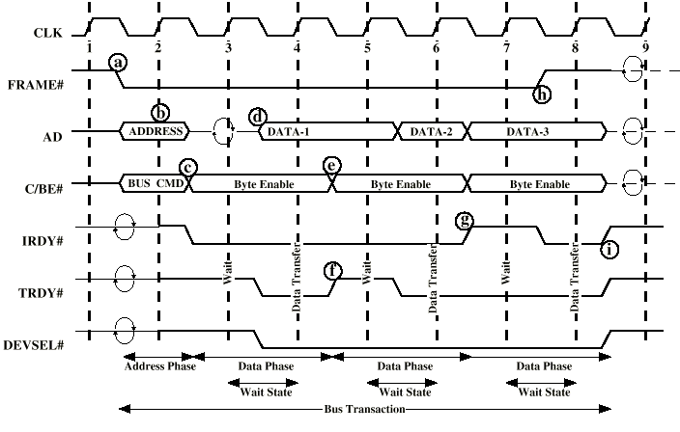
PCI Read Timing Diagram

Slide 53
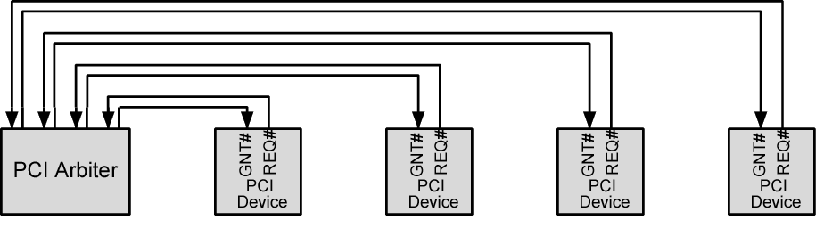
PCI Bus Arbiter

Slide 54
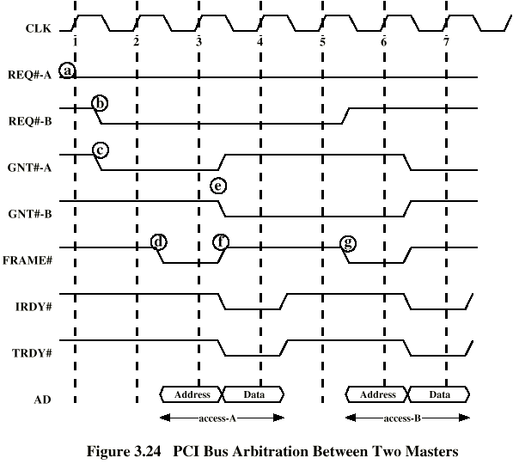
PCI Bus Arbitration

Slide 55
References
William Stallings , Computer Organization and Architecture 8th Edition. (chapter 3).
www.pcguide.com/ref/mbsys/buses/
www.pcguide.com/

